Slide 1
Covectors
Part 2: Covector Components

Slide 2



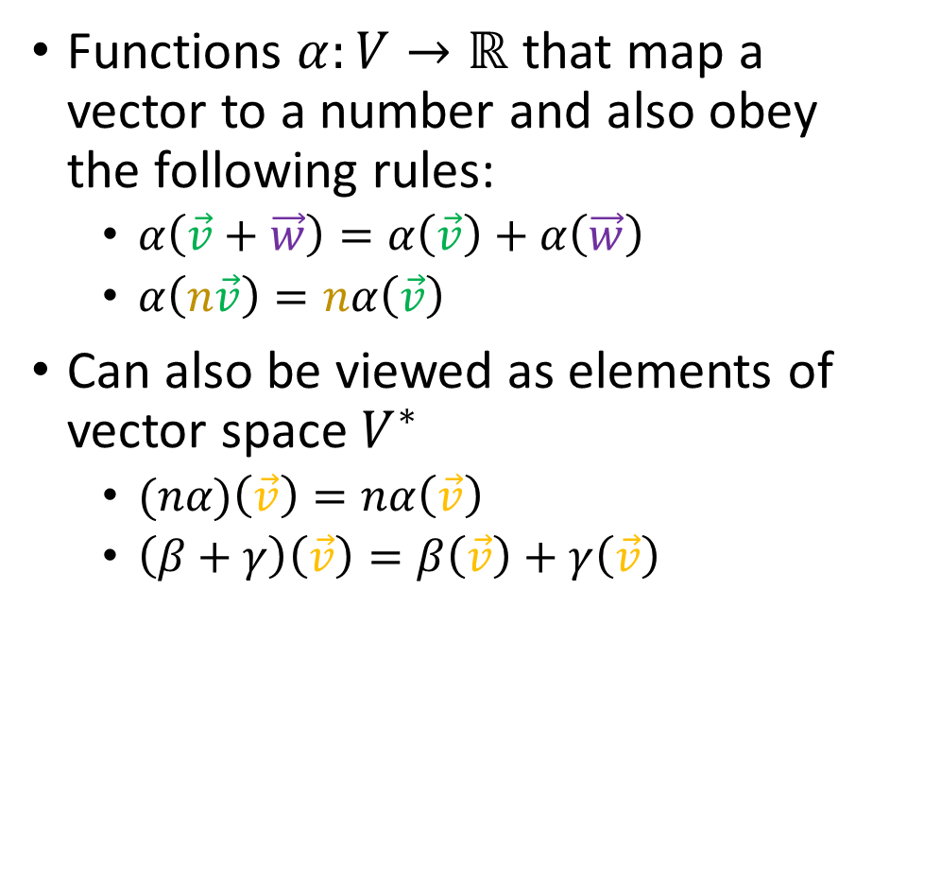
Covectors are…
Functions $α:V→ℝ$ that map a vector to a number and also obey the following rules:
$α\left(\vec{v}+\vec{w}\right)=α\left(\vec{v}\right)+α\left(\vec{w}\right)$
$α\left(n\vec{v}\right)=nα\left(\vec{v}\right)$
Can also be viewed as elements of vector space $V^{∗}$
$(nα)\left(\vec{v}\right)=nα\left(\vec{v}\right)$
$\left(β+γ\right)\left(\vec{v}\right)=β\left(\vec{v}\right)+γ\left(\vec{v}\right)$
We can visualize them as (oriented) stacks:
$$α$$
$$\vec{v}$$

Slide 3
CoVectors are Invariant CoVector components are not invariant

Slide 4
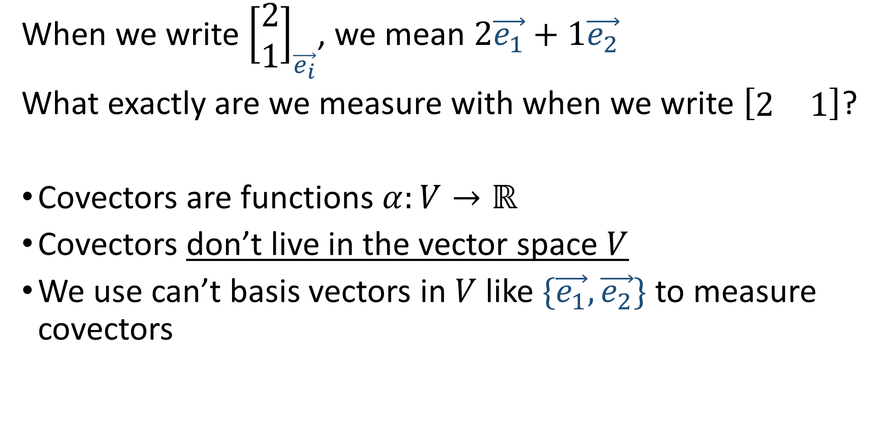
When we write ${\left[\begin{matrix}2 \\ 1\end{matrix}\right]}_{\vec{e_{i}}}$, we mean $2\vec{e_{1}}+1\vec{e_{2}}$
What exactly are we measure with when we write $\left[\begin{matrix}2 & 1\end{matrix}\right]$?
Covectors are functions $α:V→ℝ$
Covectors don’t live in the vector space $V$
We use can’t basis vectors in $V$ like $\{\vec{e_{1}},\vec{e_{2}}\}$ to measure covectors

Slide 5
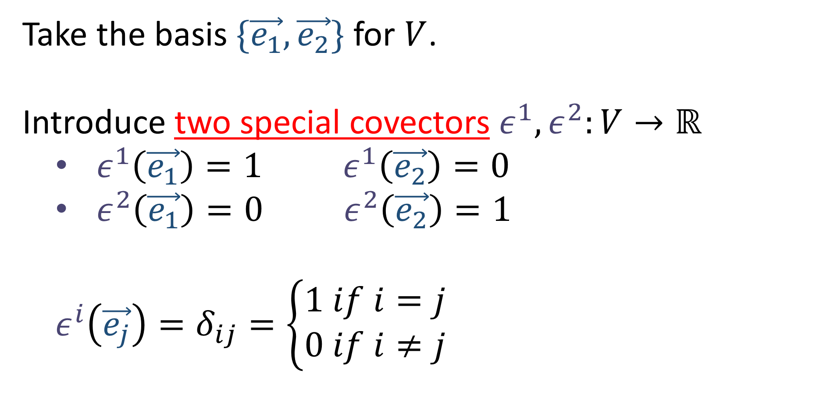

Take the basis $\{\vec{e_{1}},\vec{e_{2}}\}$ for $V$.
Introduce two special covectors $ε^{1},ε^{2}:V→ℝ$
$ε^{1}\left(\vec{e_{1}}\right)=1 ε^{1}\left(\vec{e_{2}}\right)=0$
$ε^{2}\left(\vec{e_{1}}\right)=0 ε^{2}\left(\vec{e_{2}}\right)=1$
$$ε^{i}\left(\vec{e_{j}}\right)=δ_{ij}=\left\{\begin{aligned}1 if i=j \\ 0 if i≠j\end{aligned}\right.$$

Slide 6
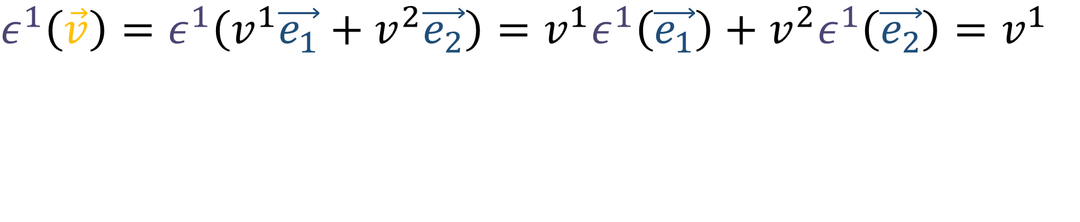
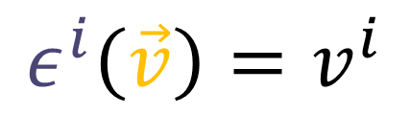


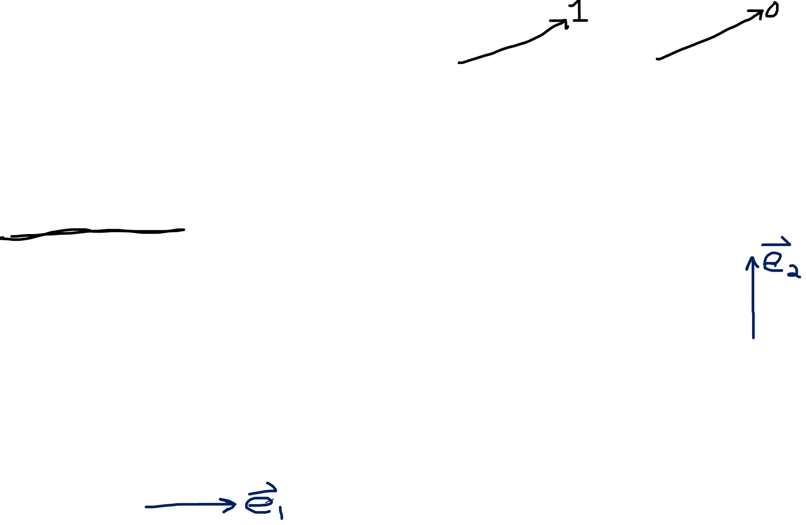
$$ε^{1}\left(\vec{v}\right)=ε^{1}\left(v^{1}\vec{e_{1}}+v^{2}\vec{e_{2}}\right)=v^{1}ε^{1}\left(\vec{e_{1}}\right)+v^{2}ε^{1}\left(\vec{e_{2}}\right)=v^{1}$$
$$ε^{2}\left(\vec{v}\right)=ε^{2}\left(v^{1}\vec{e_{1}}+v^{2}\vec{e_{2}}\right)=v^{1}ε^{2}\left(\vec{e_{1}}\right)+v^{2}ε^{2}\left(\vec{e_{2}}\right)=v^{2}$$
$$ε^{i}\left(\vec{v}\right)=v^{i}$$
$$ε^{2}$$
$$ε^{1}$$

Slide 7
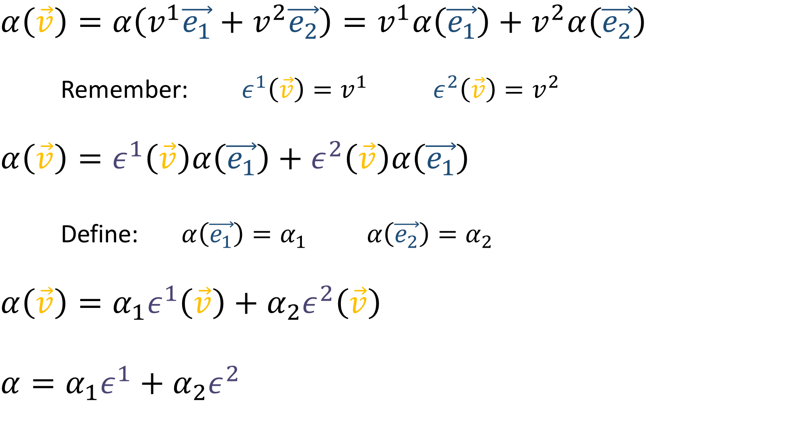
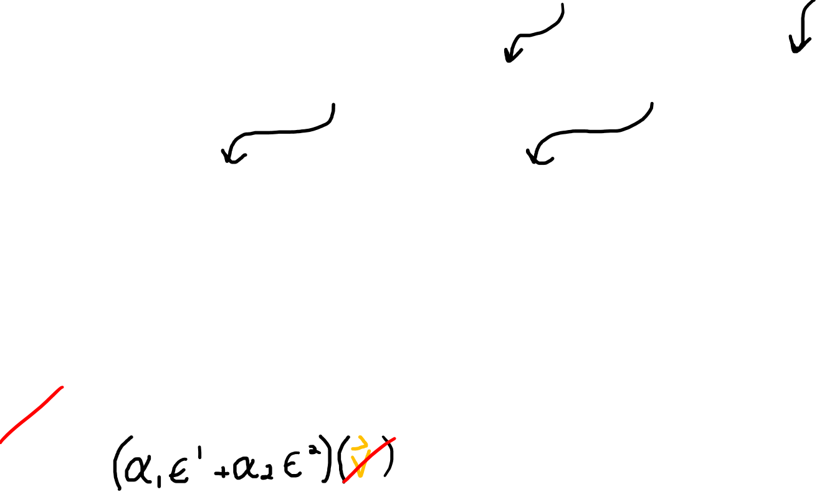
$$α\left(\vec{v}\right)=α\left(v^{1}\vec{e_{1}}+v^{2}\vec{e_{2}}\right)=v^{1}α\left(\vec{e_{1}}\right)+v^{2}α\left(\vec{e_{2}}\right)$$
Remember: $ε^{1}\left(\vec{v}\right)=v^{1}$ $ε^{2}\left(\vec{v}\right)=v^{2}$
$$α\left(\vec{v}\right)=ε^{1}\left(\vec{v}\right)α\left(\vec{e_{1}}\right)+ε^{2}\left(\vec{v}\right)α\left(\vec{e_{1}}\right)$$
Define: $α\left(\vec{e_{1}}\right)=α_{1} α\left(\vec{e_{2}}\right)=α_{2}$
$$α\left(\vec{v}\right)=α_{1}ε^{1}\left(\vec{v}\right)+α_{2}ε^{2}\left(\vec{v}\right)$$
$$α=α_{1}ε^{1}+α_{2}ε^{2}$$
Dual Basis

Slide 8








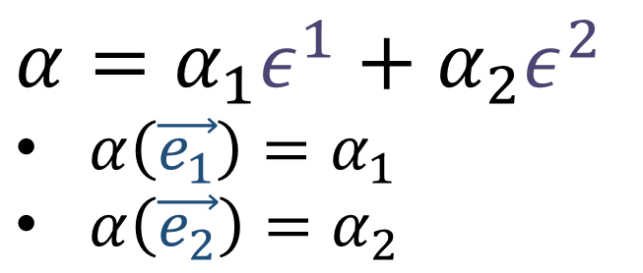


$$α=α_{1}ε^{1}+α_{2}ε^{2}$$
$α\left(\vec{e_{1}}\right)=α_{1}$
$α\left(\vec{e_{2}}\right)=α_{2}$
$$α$$
$$\vec{e_{2}}$$
$$\vec{e_{1}}$$
$$α$$
$$ε^{1}$$
$$ε^{2}$$
$$=$$
$$α_{1}$$
$$+$$
$$α_{2}$$

Slide 9

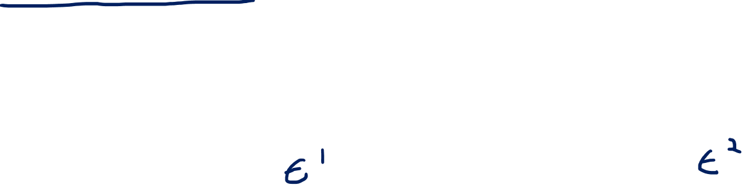

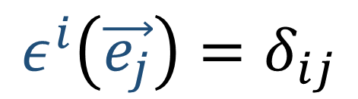






$$\vec{e_{2}}$$
$$ε^{1}$$
$$ε^{2}$$
$$\vec{e_{1}}$$
$$ε^{i}\left(\vec{e_{j}}\right)=δ_{ij}$$
$$=$$
$$α_{1}$$
$$+$$
$$α_{2}$$

Slide 10




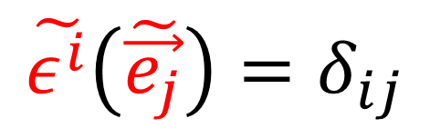
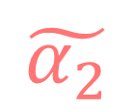
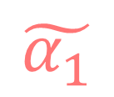

$$\tilde{ε^{1}}$$
$$\tilde{ε^{2}}$$
$$\tilde{\vec{e_{1}}}$$
$$\tilde{\vec{e_{2}}}$$
$$\tilde{ε^{i}}\left(\tilde{\vec{e_{j}}}\right)=δ_{ij}$$
$$=$$
$$\tilde{α_{1}}$$
$$+$$
$$\tilde{α_{2}}$$

Slide 11



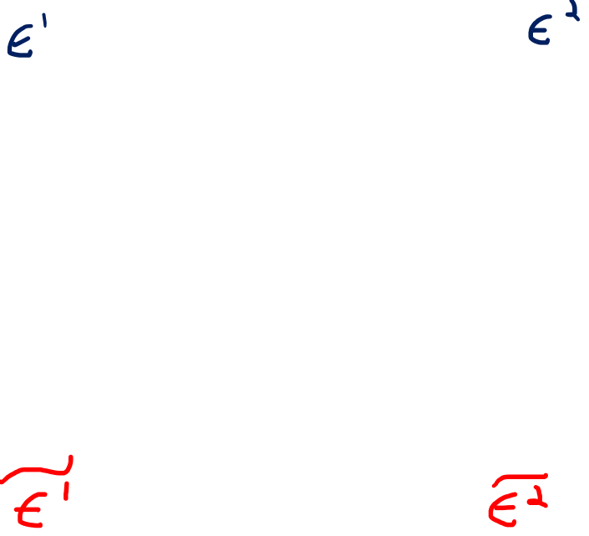



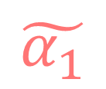

$$=$$
$$α_{1}$$
$$α_{2}$$
$$+$$
$$=$$
$$\tilde{α_{1}}$$
$$+$$
$$\tilde{α_{2}}$$

Slide 12
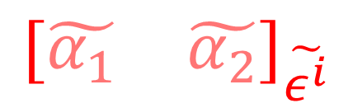
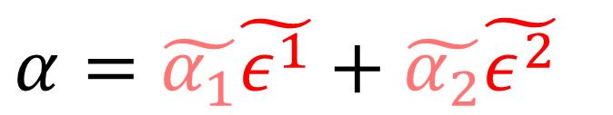
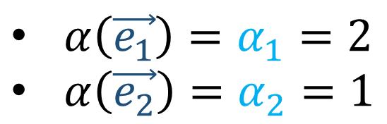

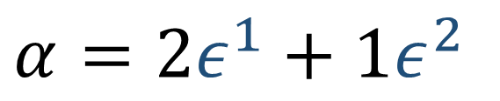
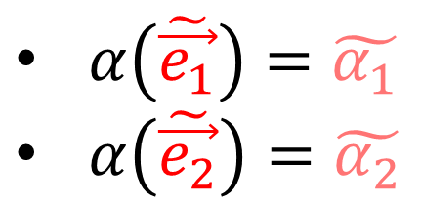
$$α=2ε^{1}+1ε^{2}$$
$$α=\tilde{α_{1}}\tilde{ε^{1}}+\tilde{α_{2}}\tilde{ε^{2}}$$
$${\left[\begin{matrix}2 & 1\end{matrix}\right]}_{ε^{i}}$$
$${\left[\begin{matrix}\tilde{α_{1}} & \tilde{α_{2}}\end{matrix}\right]}_{\tilde{ε^{i}}}$$
$α\left(\vec{e_{1}}\right)=α_{1}=2$
$α\left(\vec{e_{2}}\right)=α_{2}=1$
$α\left(\tilde{\vec{e_{1}}}\right)=\tilde{α_{1}}$
$α\left(\tilde{\vec{e_{2}}}\right)=\tilde{α_{2}}$

Slide 13
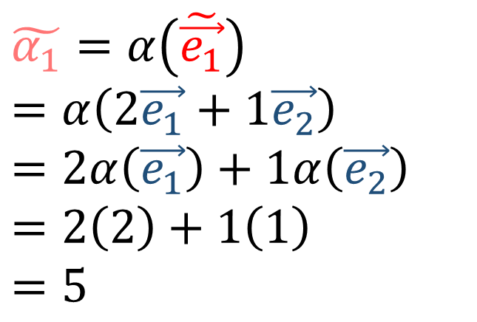
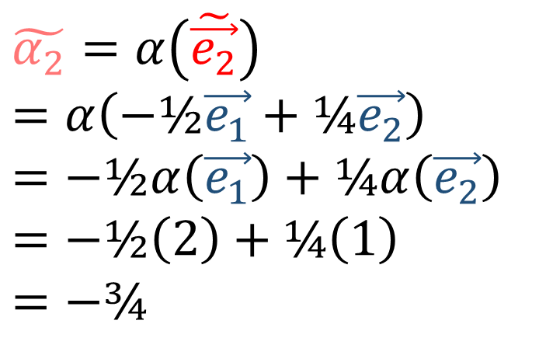
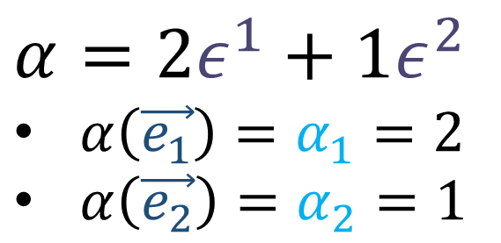
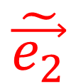
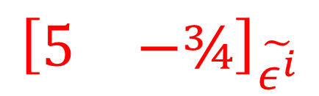
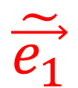
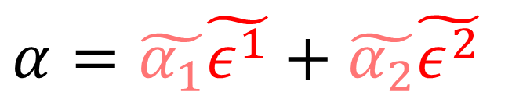
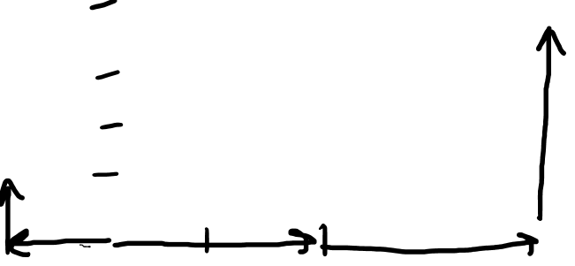
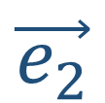


$$α=2ε^{1}+1ε^{2}$$
$α\left(\vec{e_{1}}\right)=α_{1}=2$
$α\left(\vec{e_{2}}\right)=α_{2}=1$
$$\vec{e_{2}}$$
$$\tilde{\vec{e_{1}}}$$
$$\tilde{\vec{e_{2}}}$$
$$α=\tilde{α_{1}}\tilde{ε^{1}}+\tilde{α_{2}}\tilde{ε^{2}}$$
$$\vec{e_{1}}$$
$$\tilde{α_{1}}=α\left(\tilde{\vec{e_{1}}}\right)$$
$$=α\left(2\vec{e_{1}}+1\vec{e_{2}}\right)$$
$$=2α\left(\vec{e_{1}}\right)+1α\left(\vec{e_{2}}\right)$$
$$=2\left(2\right)+1\left(1\right)$$
$$=5$$
$$\tilde{α_{2}}=α\left(\tilde{\vec{e_{2}}}\right)$$
$$=α\left(−\text{½}\vec{e_{1}}+\text{¼}\vec{e_{2}}\right)$$
$$=−\text{½}α\left(\vec{e_{1}}\right)+\text{¼}α\left(\vec{e_{2}}\right)$$
$$=−\text{½}\left(2\right)+\text{¼}\left(1\right)$$
$$=−\text{¾}$$
$${\left[\begin{matrix}2 & 1\end{matrix}\right]}_{ε^{i}}$$
$${\left[\begin{matrix}5 & −\text{¾}\end{matrix}\right]}_{\tilde{ε^{i}}}$$

Slide 14



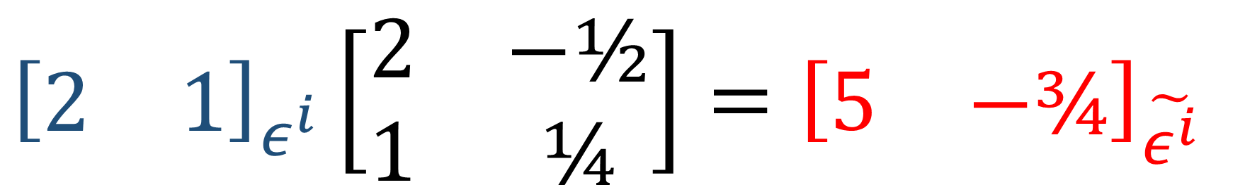
$${\left[\begin{matrix}2 & 1\end{matrix}\right]}_{ε^{i}}\left[\begin{matrix}2 & −\text{½} \\ 1 & \text{¼}\end{matrix}\right]={\left[\begin{matrix}5 & −\text{¾}\end{matrix}\right]}_{\tilde{ε^{i}}}$$
$${\left[\begin{matrix}2 & 1\end{matrix}\right]}_{ε^{i}}F={\left[\begin{matrix}5 & −\text{¾}\end{matrix}\right]}_{\tilde{ε^{i}}}$$
$${\left[\begin{matrix}5 & −\text{¾}\end{matrix}\right]}_{\tilde{ε^{i}}}B={\left[\begin{matrix}2 & 1\end{matrix}\right]}_{ε^{i}}$$

Slide 15
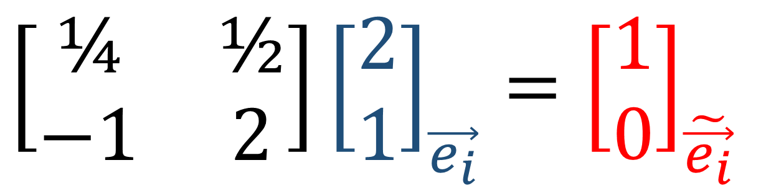

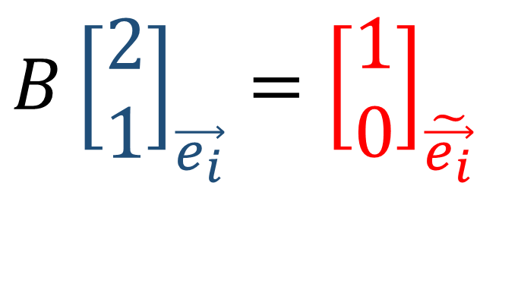
$$\left[\begin{matrix}\text{¼} & \text{½} \\ −1 & 2\end{matrix}\right]{\left[\begin{aligned}2 \\ 1\end{aligned}\right]}_{\vec{e_{i}}}={\left[\begin{aligned}1 \\ 0\end{aligned}\right]}_{\tilde{\vec{e_{i}}}}$$
$$B{\left[\begin{aligned}2 \\ 1\end{aligned}\right]}_{\vec{e_{i}}}={\left[\begin{aligned}1 \\ 0\end{aligned}\right]}_{\tilde{\vec{e_{i}}}}$$
$$F{\left[\begin{aligned}1 \\ 0\end{aligned}\right]}_{\tilde{\vec{e_{i}}}}={\left[\begin{aligned}2 \\ 1\end{aligned}\right]}_{\vec{e_{i}}}$$

Slide 16

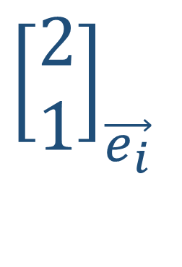



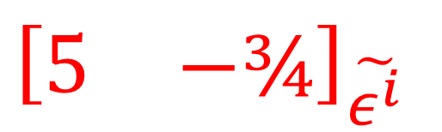

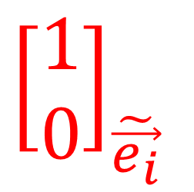

$${\left[\begin{aligned}2 \\ 1\end{aligned}\right]}_{\vec{e_{i}}}$$
$$\vec{e_{2}}$$
$${\left[\begin{matrix}2 & 1\end{matrix}\right]}_{ε^{i}}$$
$$\tilde{\vec{e_{1}}}$$
$$\tilde{\vec{e_{2}}}$$
$$\vec{e_{1}}$$
$${\left[\begin{aligned}1 \\ 0\end{aligned}\right]}_{\tilde{\vec{e_{i}}}}$$
$${\left[\begin{matrix}5 & −\text{¾}\end{matrix}\right]}_{\tilde{ε^{i}}}$$

Slide 17
Covectors
Part 3: Covector Transformation Rules

Slide 18
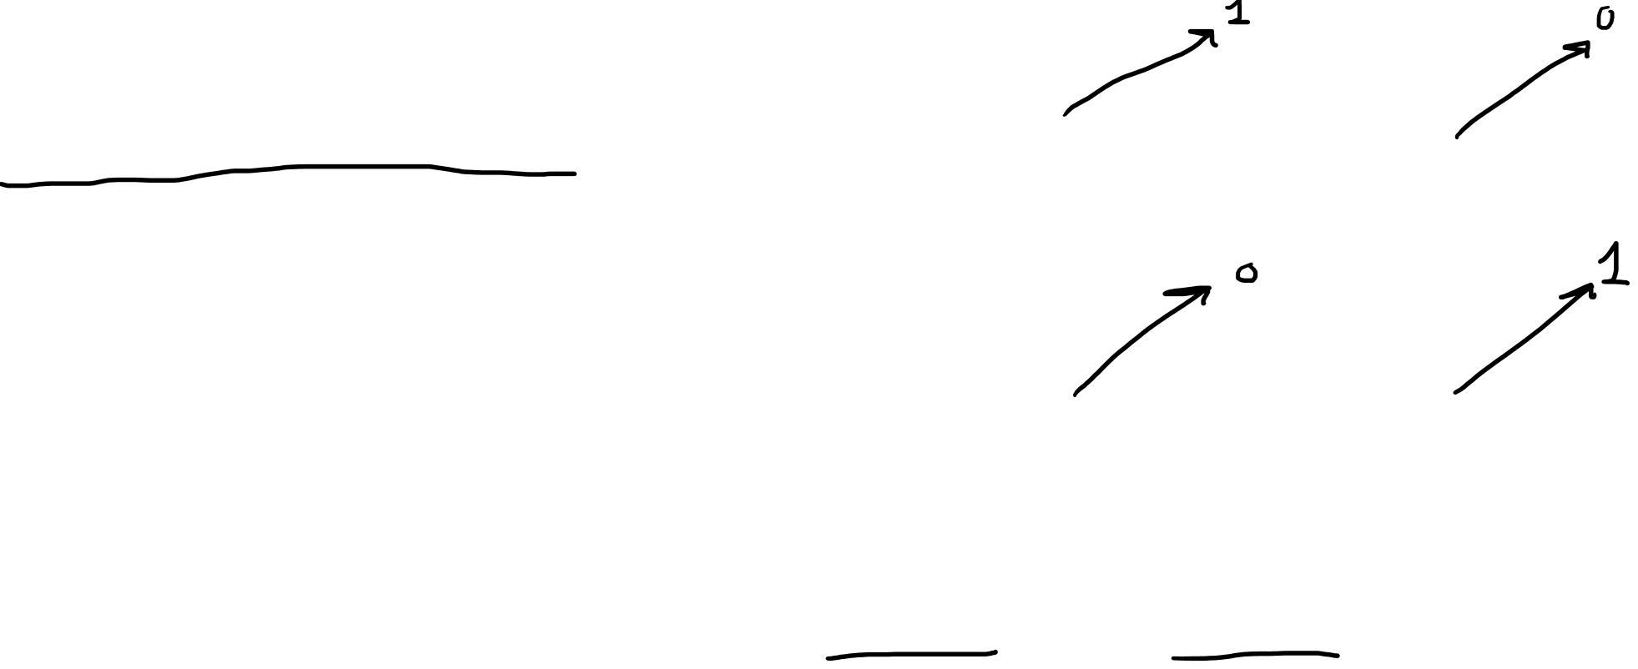
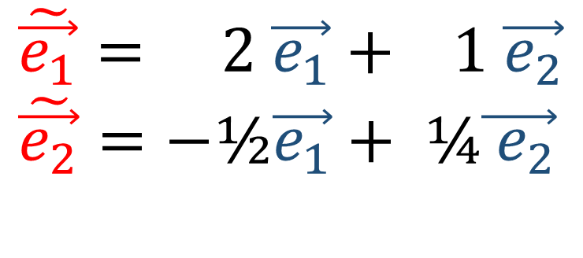


$$\tilde{\vec{e_{1}}}= 2 \vec{e_{1}}+ 1 \vec{e_{2}} \\ \tilde{\vec{e_{2}}}=−\text{½}\vec{e_{1}}+ \text{¼}\vec{{ e}_{2}}$$
$$\tilde{ε^{1}}\left(\vec{e_{1}}\right)=Q_{11}ε^{1}\left(\vec{e_{1}}\right)+Q_{12}ε^{2}\left(\vec{e_{1}}\right)$$
$$\tilde{ε^{1}}\left(\vec{e_{1}}\right)=Q_{11}$$
$$\tilde{ε^{1}}\left(\vec{e_{2}}\right)=Q_{11}ε^{1}\left(\vec{e_{2}}\right)+Q_{12}ε^{2}\left(\vec{e_{2}}\right)$$
$$\tilde{ε^{1}}\left(\vec{e_{2}}\right)=Q_{12}$$
$$\tilde{ε^{1}}=\tilde{ε^{1}}\left(\vec{e_{1}}\right)ε^{1}+\tilde{ε^{1}}\left(\vec{e_{2}}\right)ε^{2}$$
$$\tilde{ε^{1}}=Q_{11}ε^{1}+Q_{12}ε^{2}$$
$$\tilde{ε^{2}}=Q_{21}ε^{1}+Q_{22}ε^{2}$$

Slide 19



$$\tilde{\vec{e_{1}}}= 2 \vec{e_{1}}+ 1 \vec{e_{2}} \\ \tilde{\vec{e_{2}}}=−\text{½}\vec{e_{1}}+ \text{¼}\vec{{ e}_{2}}$$
$$\tilde{ε^{1}}=\tilde{ε^{1}}\left(\vec{e_{1}}\right)ε^{1}+\tilde{ε^{1}}\left(\vec{e_{2}}\right)ε^{2}$$
$$\tilde{ε^{1}}=\tilde{ε^{1}}\left(\text{¼} \tilde{\vec{e_{1}}}+ \left(−\text{1}\right)\tilde{\vec{e_{2}}}\right)ε^{1}$$ $+\tilde{ε^{1}}\left(\text{½} \tilde{\vec{e_{1}}}+\text{2} \tilde{\vec{e_{2}}}\right)ε^{2}$
$$\tilde{ε^{1}}=\left(\text{¼}\tilde{ε^{1}}\left(\tilde{\vec{e_{1}}}\right)+\left(−\text{1}\right)\tilde{ε^{1}}\left(\tilde{\vec{e_{2}}}\right)\right)ε^{1}$$ $+\left(\text{½}\tilde{ε^{1}}\left(\tilde{\vec{e_{1}}}\right)+\text{2}\tilde{ε^{1}}\left(\tilde{\vec{e_{2}}}\right)\right)ε^{2}$
$$\tilde{ε^{1}}=\text{¼} ε^{1}+\text{½} ε^{2}$$
$$\tilde{ε^{2}}=(−1)ε^{1}+\text{2} ε^{2}$$
$$\tilde{ε^{1}}=Q_{11}ε^{1}+Q_{12}ε^{2}$$
$$\tilde{ε^{2}}=Q_{21}ε^{1}+Q_{22}ε^{2}$$
$$\vec{e_{1}}= \text{¼} \tilde{\vec{e_{1}}}+ \left(−\text{1}\right)\tilde{\vec{e_{2}}}$$
$$\vec{e_{2}}= \text{½} \tilde{\vec{e_{1}}}+ \text{2} \tilde{\vec{e_{2}}}$$

Slide 20










$\{ε^{j}\}$ is the old basis for $V^{∗}$.
$\{\tilde{ε^{i}}\}$ is the new basis for $V^{∗}$.
$$ε^{i}\left(\vec{e_{j}}\right)=δ_{ij}$$
$$\tilde{\vec{e_{j}}}=\sum_{i=1}^{n}{F_{ij}\vec{e_{i}}}$$
$\tilde{ε^{i}}=Q_{i1}ε^{1}+Q_{i2}ε^{2}+…+Q_{in}ε^{n}=\sum_{i=1}^{n}{Q_{ij}ε^{j}}$
$\tilde{ε^{i}}\left(\tilde{\vec{e_{k}}}\right)=\sum_{j=0}^{n}{Q_{ij}ε^{j}\left(\tilde{\vec{e_{k}}}\right)}$
$δ_{ik}=\sum_{j=1}^{n}{Q_{ij}ε^{j}\left(\sum_{l=1}^{n}{F_{lk}\vec{e_{l}}}\right)}$
$δ_{ik}=\sum_{j=1}^{n}{\sum_{l=1}^{n}{Q_{ij}F_{lk}}ε^{j}\left(\vec{e_{l}}\right)}$
$δ_{ik}=\sum_{j=1}^{n}{\sum_{l=1}^{n}{Q_{ij}F_{lk}δ_{jl}}}$
$δ_{ik}=\sum_{j=1}^{n}{Q_{ij}F_{jk}}$
$$\tilde{ε^{i}}\left(\tilde{\vec{e_{j}}}\right)=δ_{ij}$$
$$\vec{e_{j}}=\sum_{i=1}^{n}{B_{ij}\tilde{\vec{e_{i}}}}$$
$\sum_{j}{B_{ij}F_{jk}}=δ_{ik}$
$$Q_{ij}=B_{ij}$$
$\tilde{ε^{i}}$ $=\sum_{i=0}^{n}{B_{ij}ε^{j}}$

Slide 21




$$\tilde{\vec{e_{j}}}=\sum_{i=1}^{n}{F_{ij}\vec{e_{i}}}$$
$$\tilde{ε^{i}} =\sum_{j=1}^{n}{B_{ij}ε^{j}}$$
$$\vec{e_{j}}=\sum_{i=1}^{n}{B_{ij}\tilde{\vec{e_{i}}}}$$
$$ε^{i}=\sum_{j=1}^{n}{F_{ij}\tilde{ε^{j}}}$$

Slide 22






$$\tilde{ε^{i}} =\sum_{i=1}^{n}{B_{ij}ε^{j}}$$
$α=\sum_{i=1}^{n}{α_{i}ε^{i}}=\sum_{j=1}^{n}{\tilde{α_{j}}\tilde{ε^{j}}}$
$α=\sum_{i=1}^{n}{α_{i}ε^{i}}$
$=\sum_{i=1}^{n}{α_{i}\sum_{j=1}^{n}{F_{ij}\tilde{ε^{j}}}}$
$=\sum_{j=1}^{n}{\left(\sum_{j=1}^{n}{α_{i}F_{ij}}\right)\tilde{ε^{j}}}$
$$ε^{i}=\sum_{i=1}^{n}{F_{ij}\tilde{ε^{j}}}$$
$$\tilde{α_{j}}=\sum_{i=1}^{n}{F_{ij}α_{i}}$$
$$α_{j}=\sum_{i=1}^{n}{B_{ij}\tilde{α_{i}}}$$

Slide 23





$$\tilde{\vec{e_{2}}}$$
$$\vec{e_{2}}$$
$$\vec{e_{1}}$$
$$\tilde{\vec{e_{1}}}$$

Slide 24









$$\tilde{\vec{e_{j}}}=\sum_{i=1}^{n}{F_{ij}\vec{e_{i}}}$$
$$\tilde{ε^{i}} =\sum_{j=1}^{n}{B_{ij}ε^{j}}$$
Contravariant
$$\vec{e_{j}}=\sum_{i=1}^{n}{B_{ij}\tilde{\vec{e_{i}}}}$$
$$ε^{i}=\sum_{j=1}^{n}{F_{ij}\tilde{ε^{j}}}$$
$$\tilde{v^{i}}=\sum_{j=1}^{n}{B_{ij}v^{j}}$$
$$\tilde{α_{j}}=\sum_{i=1}^{n}{F_{ij}α_{i}}$$
Covariant
Contravariant
$$v^{i}=\sum_{j=1}^{n}{F_{ij}\tilde{v^{j}}}$$
$$α_{j}=\sum_{i=1}^{n}{B_{ij}\tilde{α_{i}}}$$

